Slide 1

Keyless Kingdom A cloud solution: Raspberry Pi & RFID Open Doors to the Future!
Matthew Mendoza for CSC 196P: Cloud and Mobile Pragmatics

Slide 2
Breaking Boundaries A cloud solution: Raspberry Pi + RFID = Your Passport to Innovation!
Matthew Mendoza for CSC 196P: Cloud and Mobile Pragmatics

Slide 3
Unlocking the Future A cloud solution: Harnessing Raspberry Pi and RFID for Limitless Possibilities!
Matthew Mendoza for CSC 196P: Cloud and Mobile Pragmatics

Slide 4
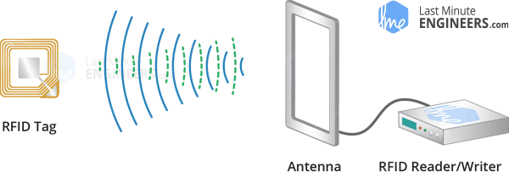
RECAP Radio Frequency Identification (RFID)
What is RFID Technology
How does it work?
RFID is a wireless technology for identifying and tracking objects.
Applications include inventory management, supply chain logistics, access control, and contactless payment systems.
RFID offers advantages like improved inventory accuracy and faster data collection.
It uses electromagnetic fields to communicate between tags and readers.
Tags consist of a microchip and an antenna.
When within range of an RFID reader, the reader sends out radio waves.
These waves power the tag, enabling it to transmit data back to the reader.
Data typically includes unique identifiers or stored information on the tag.
Source: Wikipedia - Radio-frequency identification - Last Minute Engineers - What is RFID? How It Works? Interface RC522 RFID Module with Arduino

Slide 5

The Setup

Slide 6
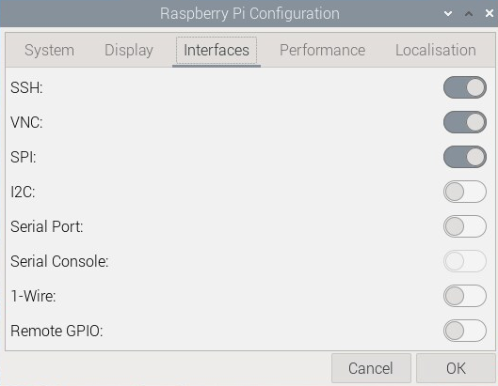
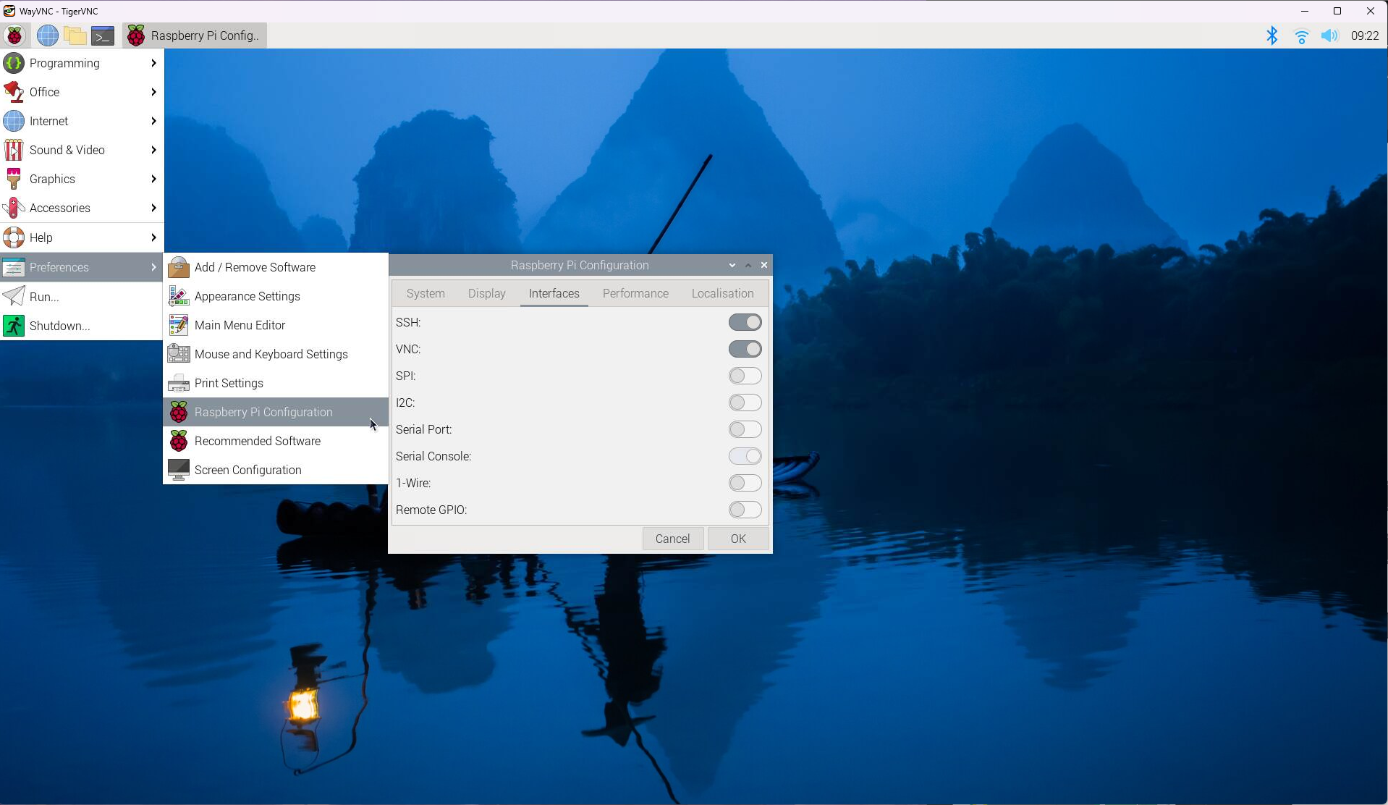
Configure Raspberry Pi for RFID READER (RFIO-RC522)
Enable Serial Peripheral Interface (SPI) connection
an interface bus commonly used to send data between microcontrollers and small peripherals such as shift registers, sensors, and SD cards. It uses separate clock and data lines, along with a select line to choose the device you wish to talk to.
1
2
3
Source: Pinout.xyz: SPI - Serial Peripheral Interface

Slide 7
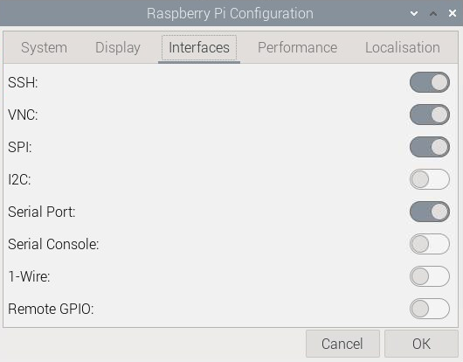
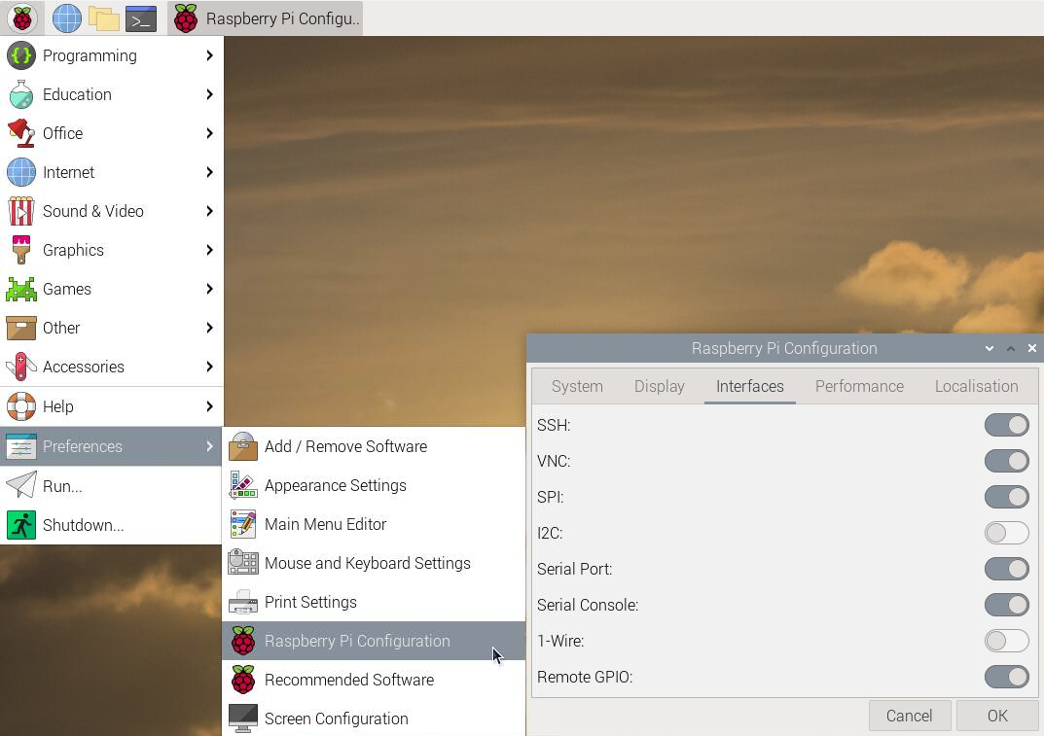
Configure Raspberry Pi for Thermal Printer
Enable UART (Universal Asynchronous Receiver-Transmitter) serial port
useful for various applications, such as communicating with other serial devices like Arduino boards, GPS modules, and other microcontrollers.
1
2
3
Source: pinout.xyz: UART - Universal Asynchronous Receiver/Transmitter

Slide 8
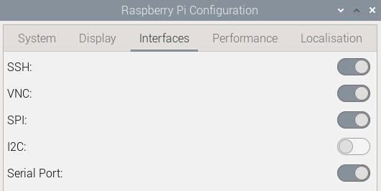
Serial Communication: SPI VS UART
Both communication protocols used for serial communication, but they have different characteristics and applications:
SPI (Serial Peripheral Interface)
UART (Universal Asynchronous Receiver-Transmitter)
Data is transferred in sync with a clock signal.
Typically involves a master device (such as a microcontroller or Raspberry Pi) and one or more slave devices (such as sensors or displays)
Uses separate lines for data (MOSI - Master Out Slave In, MISO - Master In Slave Out), clock (SCLK), and sometimes for chip select (CS) to enable communication with multiple slave devices
Data is transmitted without the need for a shared clock signal
Typically involves two devices communicating with each other using a single data line (TX - Transmit) and a single receive line (RX - Receive), along with a ground reference
UART communication is simpler and more flexible than SPI, but it tends to be slower and less efficient, especially over longer distances or in noisy environments
Unlike SPI, UART communication is not synchronous and does not require a clock signal. It operates using start and stop bits to synchronize data transmission.
Source: SPI (Serial Peripheral Interface), UART (Universal Asynchronous Receiver/Transmitter)

Slide 9
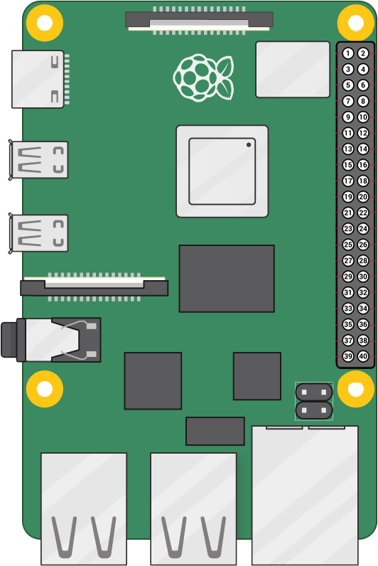
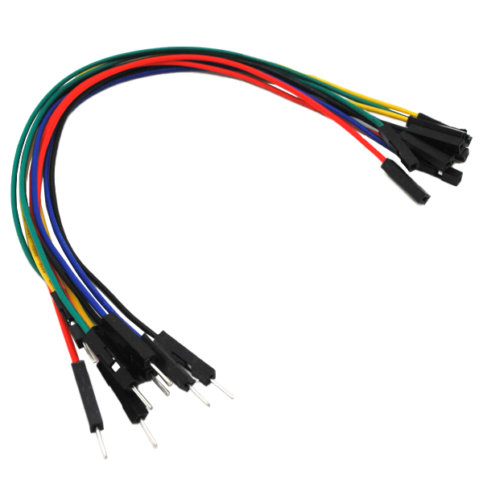
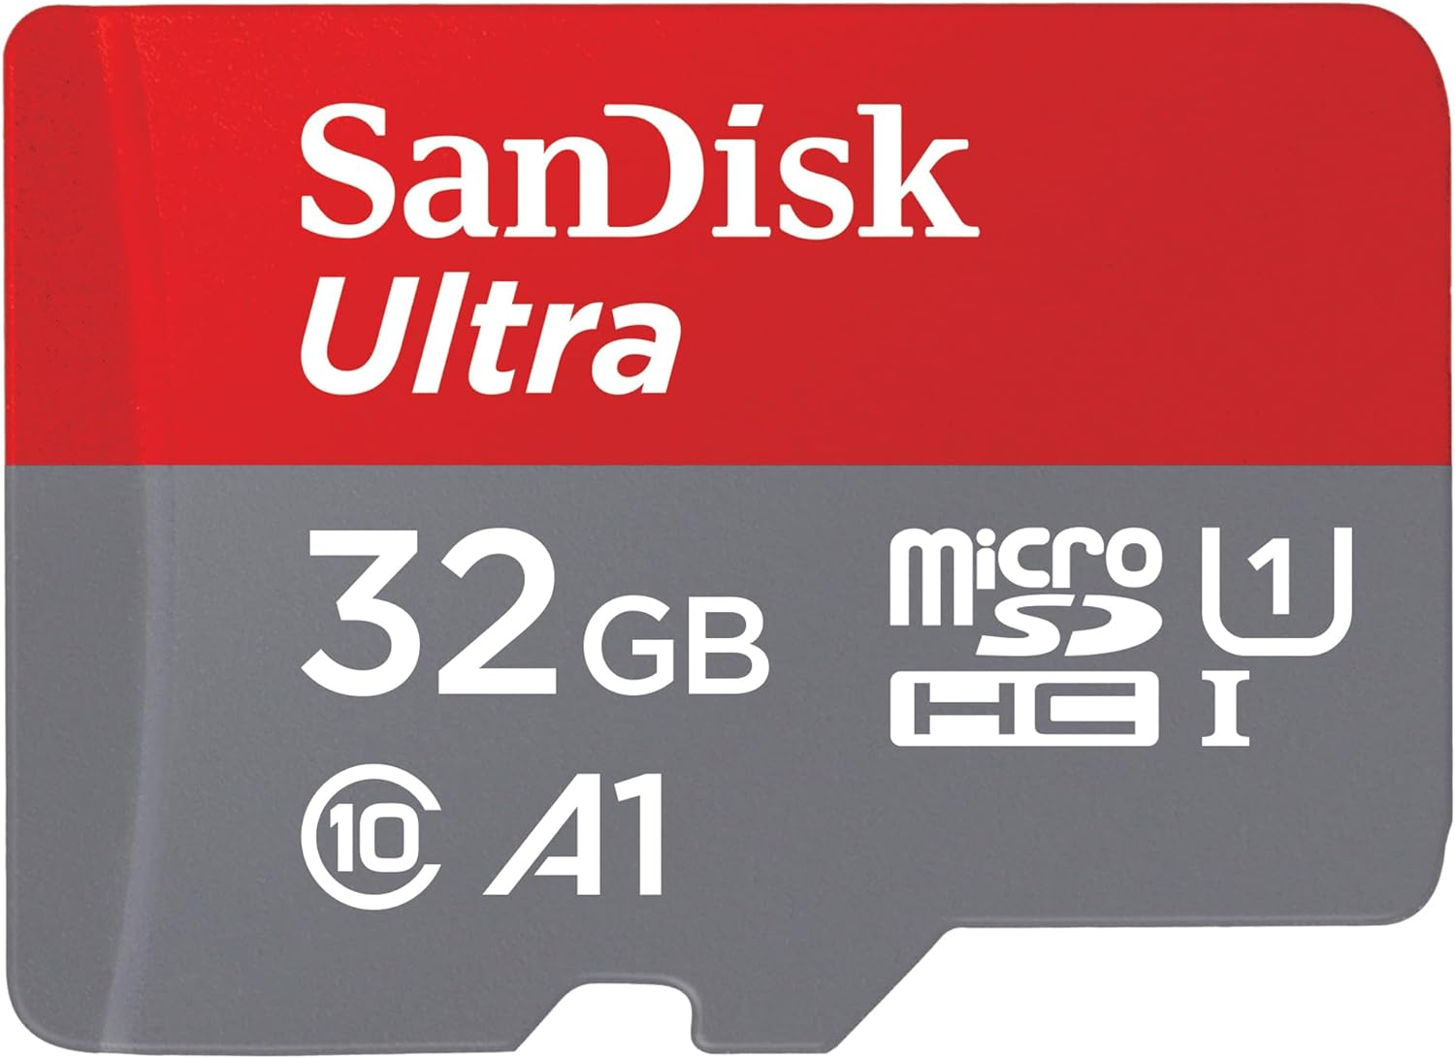
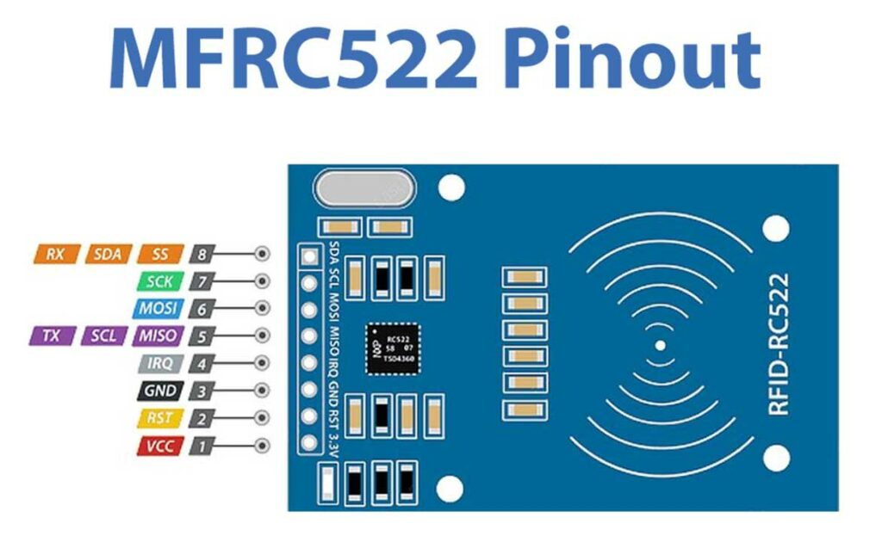
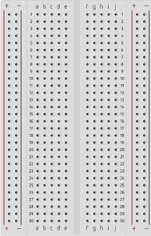


Hardware Components and Accessories
Micro SD Card
Male-Female Jumper Wires
RFID Card Tag
Key Fob Tag
Mifare RC522
Module RFID Reader
Raspberry Pi 5
Breadboard

Slide 10
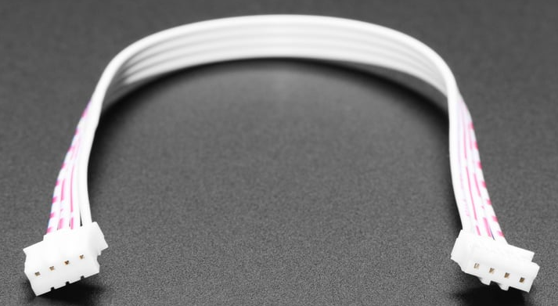
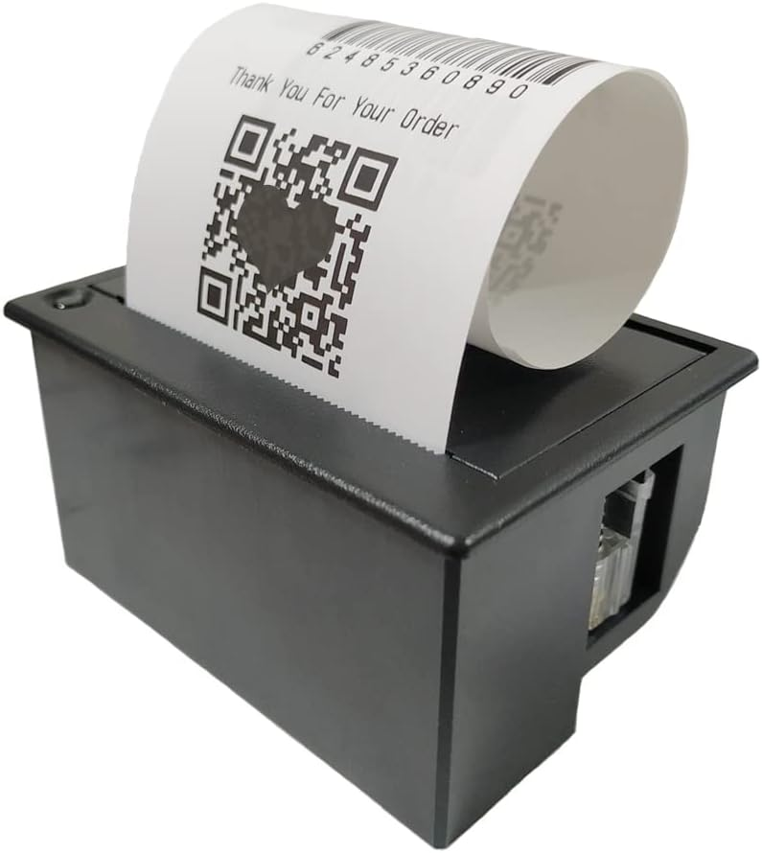
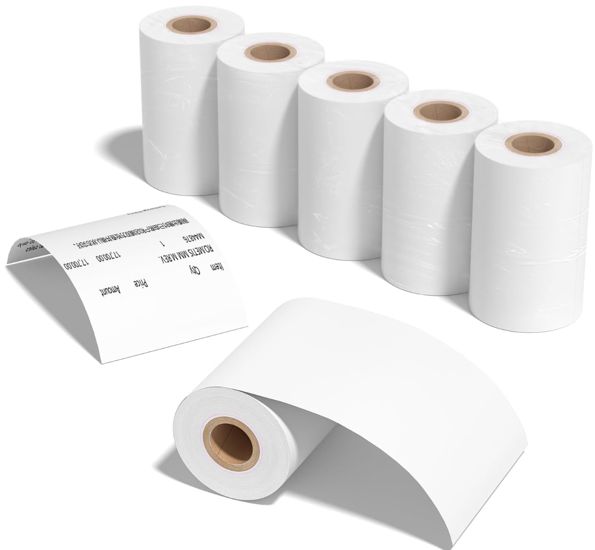
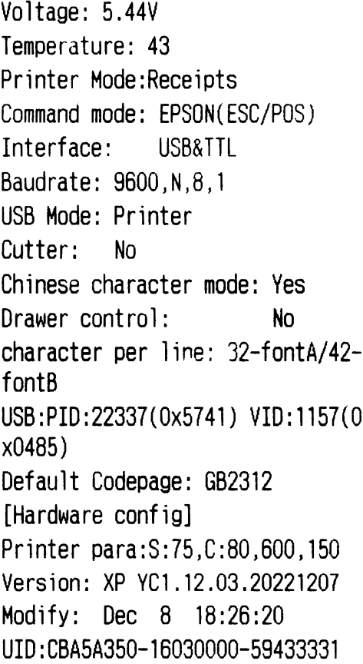
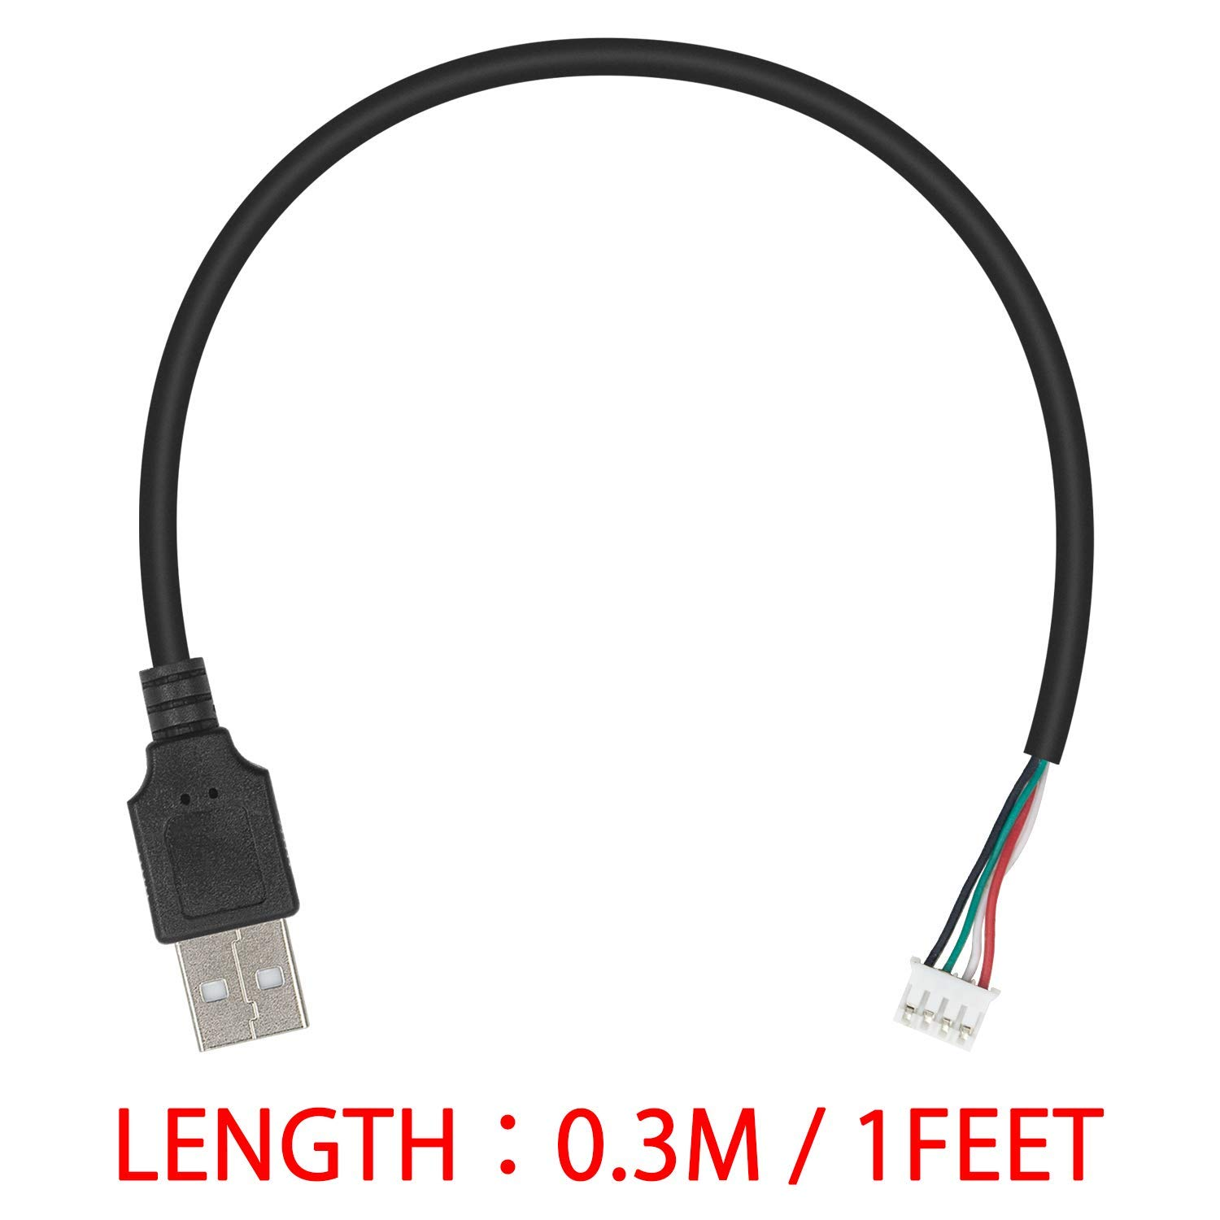

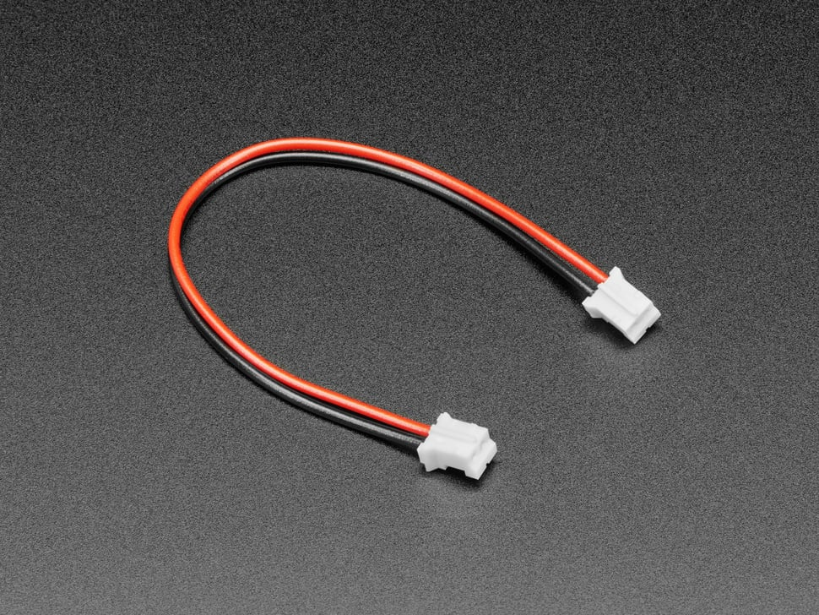
Hardware Components and Accessories
Thermal Printer Test Print
4 PIN Serial Port Line
(STEMMA Cable 4 Pin JST-PH Cable)
Thermal Paper Rolls
57mm (width) x 30mm (roll diameter)
USB 2.0 Male to 4 pin Data Cable
5~9V Embedded Thermal Receipt Printer
(Maikrt Micro Thermal Printer)
2PIN Power Terminal Cable
(JST-PH 2-pin Jumper Cable)

Slide 11

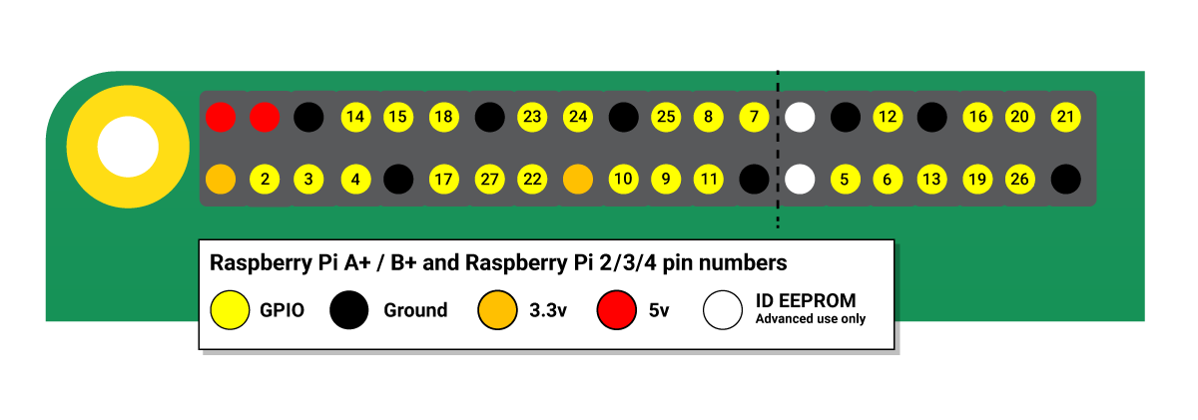
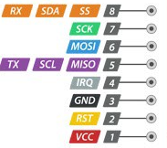
Hardware Component Pinouts
Raspberry Pi GPIO pinout
Raspberry Pi 4 Model B
Mifare RC522Module RFID Reader
Micro Thermal Printer
Source: Raspberry Pi GPIO and the 40-pin header, Interface RC522 RFID Module

Slide 12



Wiring for RFID Reader
RC522 Module (Right to Left) |  | Raspberry Pi
PIN 1: 3.3V - Voltage Common Collector (VCC) | Red | PIN 1: 3.3v
PIN 2: Reset (RST) | GOLD | PIN 22: GPIO #25
PIN 3: Ground (GND) | Black | PIN 6: Ground (GND)
PIN 4: Interrupt Request (IRQ) |  | Not connected
PIN 5: Master In Slave Out (MISO) | Purple | PIN 21: GPIO #9 (MISO)
PIN 6: Master Out Slave In (MOSI) | Blue | PIN 19: GPIO #10 (MOSI)
PIN 7: Serial Clock (SCK) | Green | PIN 23: GPIO #11 (SCLK)
PIN 8: Serial Data Line (SDA) | Orange | PIN 24: GPIO #8 (CE0)
Source: RC522 RFID Tag Reading with the Raspberry Pi
Notes:
RC522 Module PIN 1: Voltage at the Common Collector (VCC) - Used to Power the module, typically 3.3V is used
PIN 2: RST - Reset pin – used to reset or power down the module
PIN 3: Ground - Connected to Ground of system
PIN 5: MISO - used for SPI communication, acts as SCL for I2c and Tx for UART.
PIN 6: MOSI - Master out slave in pin for SPI communication
PIN 7: SCK - Serial Clock pin – used to provide clock source
PIN 8: SDA - Acts as Serial input (SS) for SPI communication, SDA for IIC and Rx during UART

Slide 13
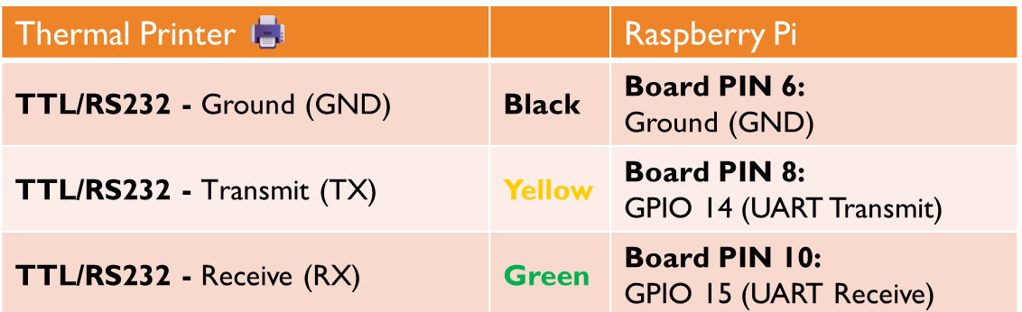

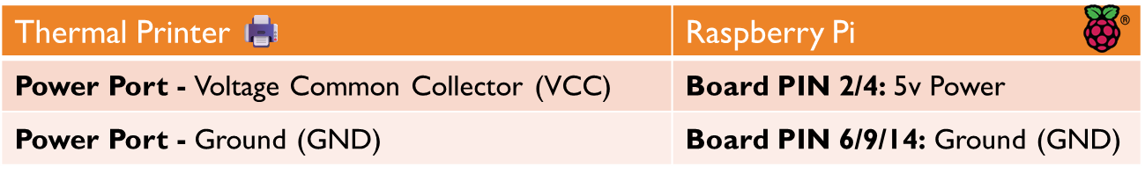
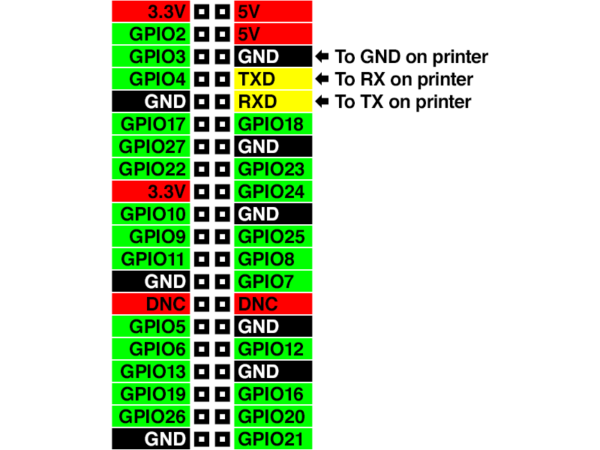
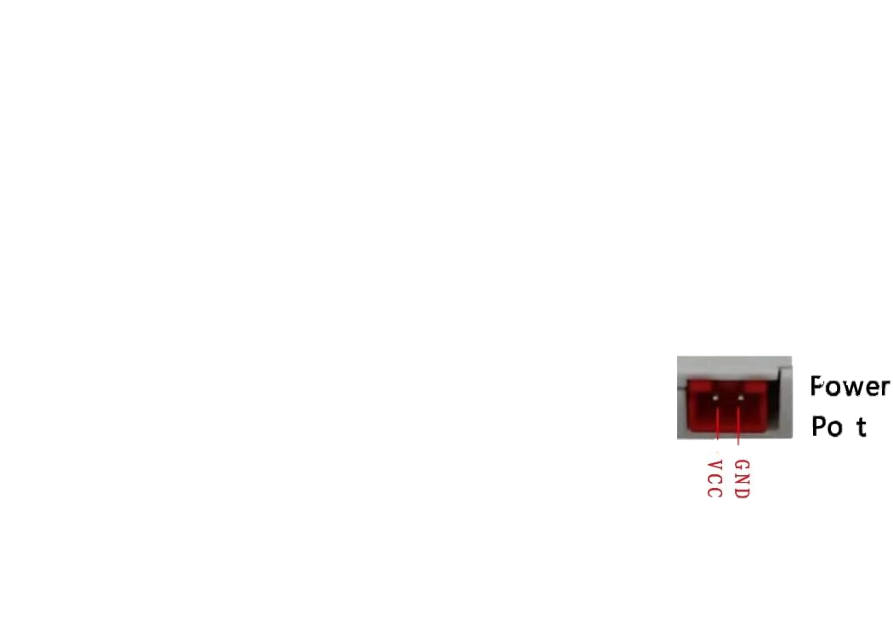
Wiring for Thermal Printer
TTL/RS262
USB
Power Port 🖨️⚡ | Raspberry Pi
Power Port - Voltage Common Collector (VCC) | Board PIN [2, 4]: 5v Power
Power Port - Ground (GND) | Board PIN [9, 14, 20, 25, 30]: Ground (GND)

Slide 14
Validate setup
TTL/RS262
TTL/RS262
USB
import serial
def print_to_serial(text):
try:
# Open the serial port at 9600 baud rate
ser = serial.Serial('/dev/serial0', 9600)
# Write the text to the serial port
ser.write(text.encode('utf-8'))
# Close the serial port
ser.close()
print("Printed successfully.")
except Exception as e:
print("Error:", e)
# Example text to print
text_to_print = "This is a test.\n\n\n"
# Call the function to print
print_to_serial(text_to_print)
def print_to_usb(text):
try:
# Open the USB printer device for writing
with open('/dev/usb/lp0', 'wb') as usb_printer:
# Write the text to the printer
usb_printer.write(text.encode('utf-8'))
print("Printed successfully.")
except Exception as e:
print("Error:", e)
# Example text to print
text_to_print = "This is a test.\n\n\n"
# Call the function to print
print_to_usb(text_to_print)
stty -F /dev/serial0 9600
echo -e "This is a test.\\n\\n\\n" > /dev/serial0
USB
sudo chmod 777 /dev/usb/lp0
echo -e "This is a test.\\n\\n\\n" > /dev/usb/lp0
In demo I’ll use USB
Source: Networked Thermal Printer using Raspberry Pi and CUPS > Connect and Configure Printer - Get to Know Your Printer

Slide 15
After the setup has been Validated: Commence Major Installation!
Make sure the package database is up-to-date, then install several packages…
sudo apt-get update
sudo apt-get install libcups2-dev libcupsimage2-dev git build-essential cups system-config-printer
Though not unusually large (about 75 MB total), there are many small pieces to process. This could take about 15 minutes to install if you’re on an older Pi, so you might want to go mow the lawn or something.
Once that’s done, download and install this CUPS filter for the thermal printer:
git clone https://github.com/adafruit/zj-58
cd zj-58
make
sudo ./install
Source: Networked Thermal Printer using Raspberry Pi and CUPS > Connect and Configure Printer - Commence Major Installation!

Slide 16



The architecture

Slide 17


RECAP Setting up the cloud via Firebase
“The cloud is just someone else's computer” [that can scale]

Slide 18
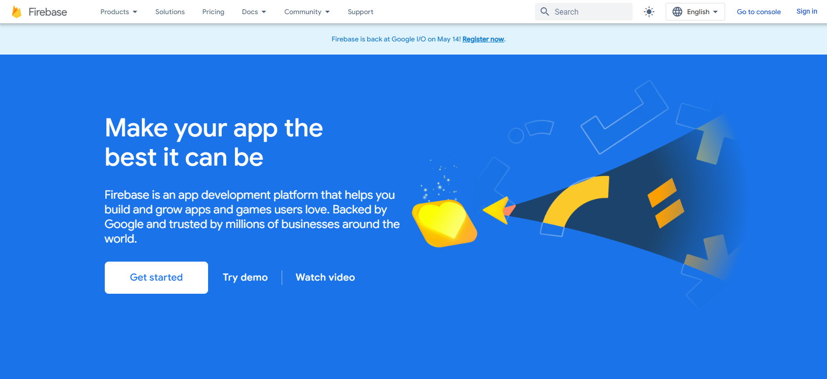
RECAP Step 1 - Sign-in with a google account
As of 2024/05/04

Slide 19
RECAP Step 2 - Go to console
As of 2024/05/04

Slide 20
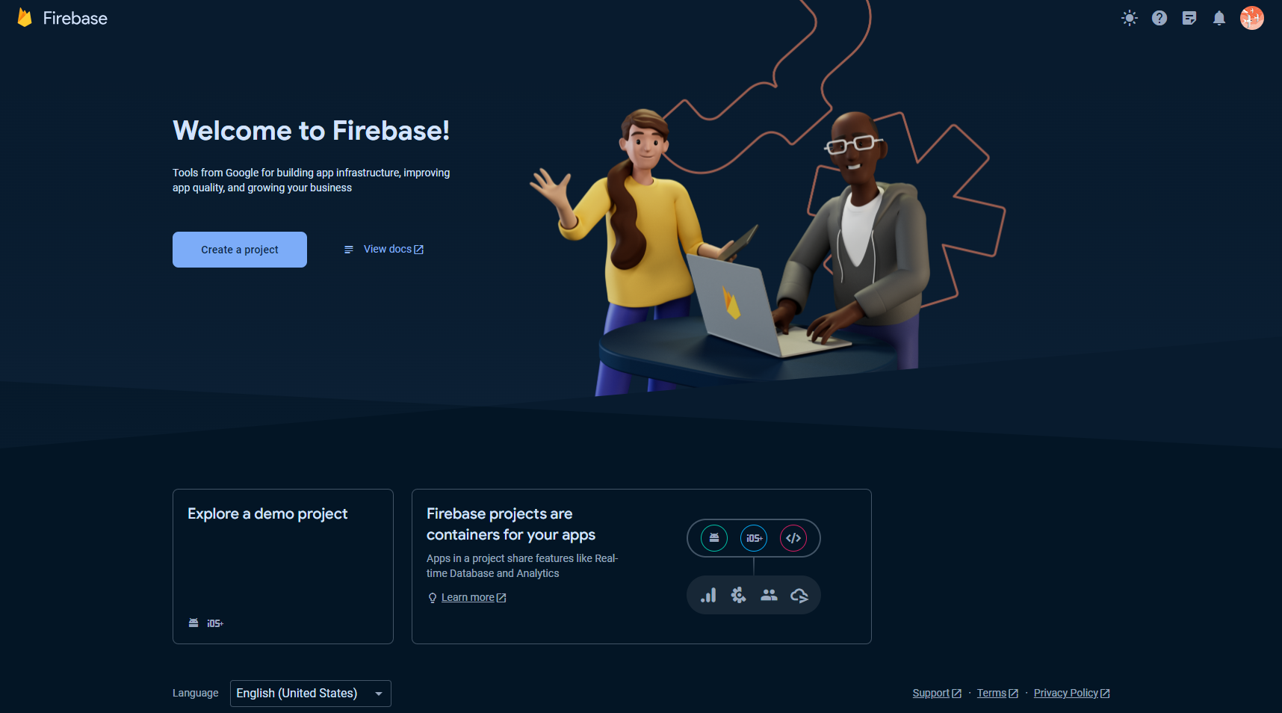
RECAP Step 3 - Create a project
As of 2024/05/04

Slide 21
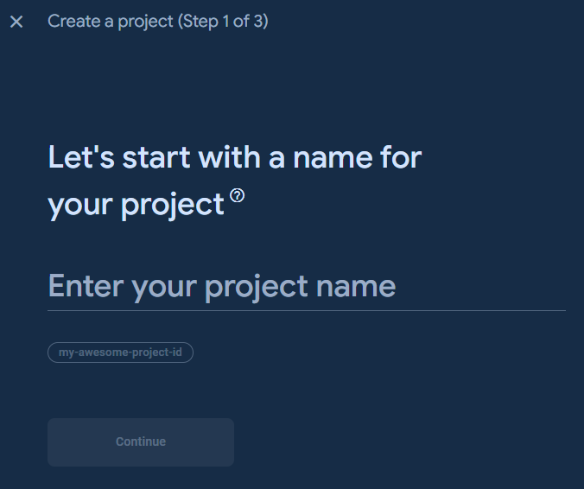

RECAP Step 4 - Create a project (Part 1 of 3)
Give your project a name and continue
As of 2024/05/04

Slide 22
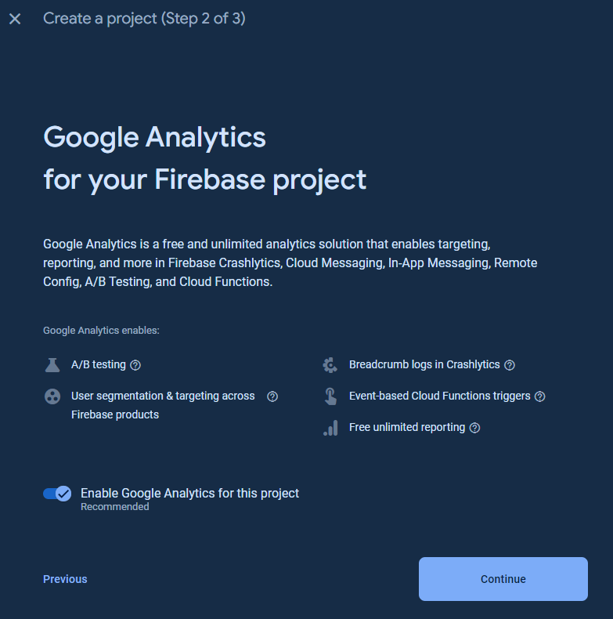
RECAP Step 5 - Create a project (Part 2 of 3)
Click Continue
Up to you to enable Google Analytics for this project
As of 2024/05/04

Slide 23
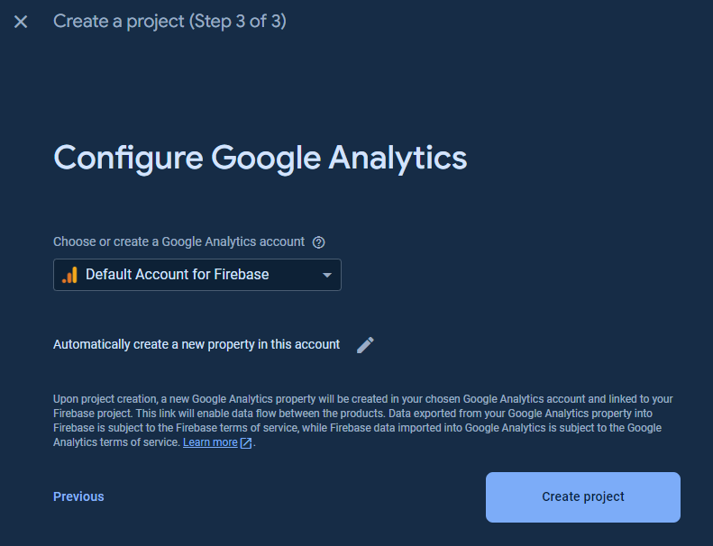
RECAP Step 6 - Create a project (Part 3 of 3)
Configure Google Analytics
As of 2024/05/04

Slide 24

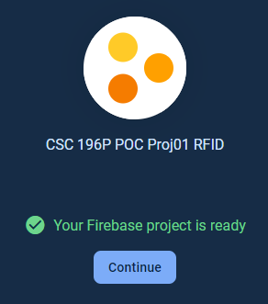
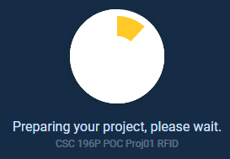
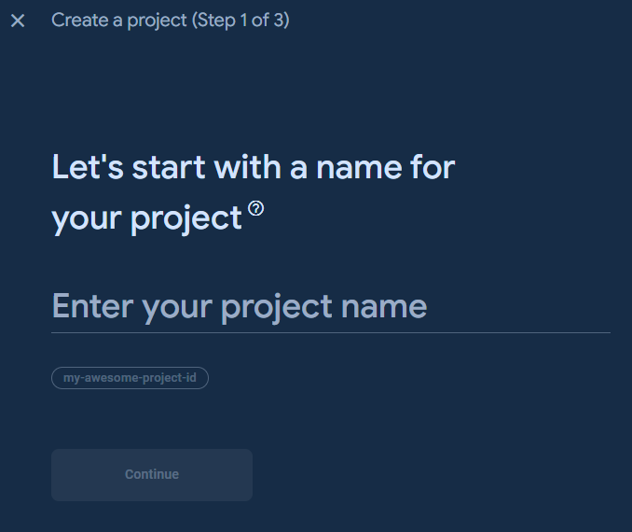
RECAP Step 7 - Wait and you’re all set
You are all set
As of 2024/05/04

Slide 25

Picking a No-SQL Database
Cloud Firestore
Firebase Realtime Database
Powerful Queries
The robust “traditional” database
Has a query builder can build queries in the console and count results.
Ideal for high write volume, small data payload
Does not charge for writes
Think IOT Sensors, constant stream of small data being up-loaded
Source: 100 Firebase Tips, Tricks, and Screw-ups by Fireship

Slide 26
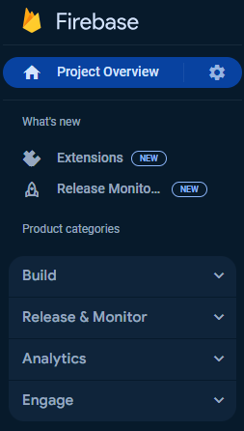
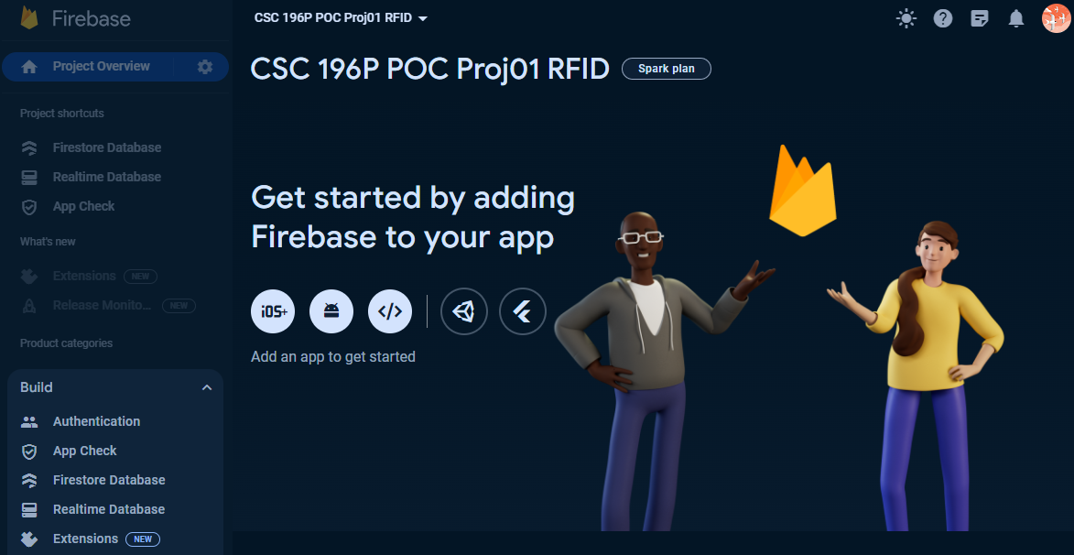
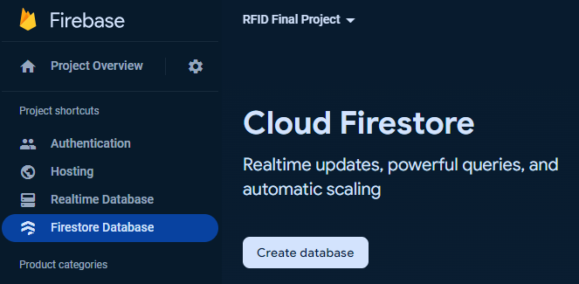
Step 1 - Create Firestore database
From “Project categories”, under “BUILD” dropdown menu, select “Firestore Database”, Click “Create Database”
As of 2024/05/04

Slide 27
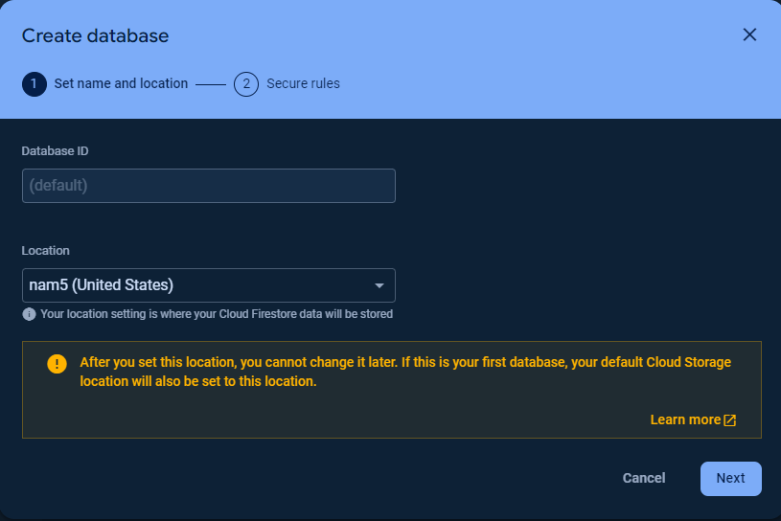
STEP 2 - Set up database (part 1 of 2)
A collection with a Database ID with the name “(default)” will be automatically generated
You’ll only need to select a location setting where your Cloud Firestore data will be stored
Select the region that best suits your geographic location
Click “Next”
As of 2024/05/04

Slide 28
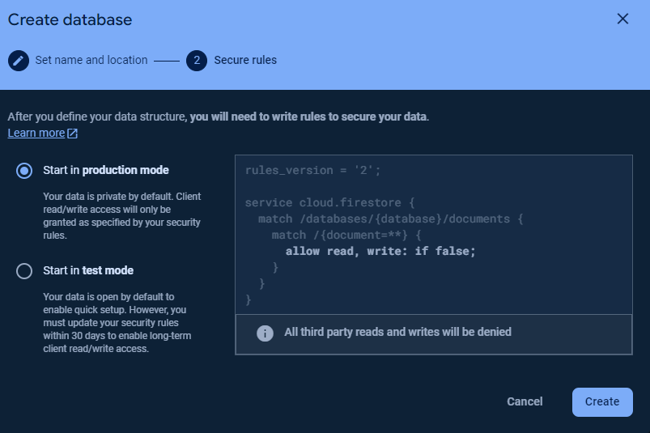
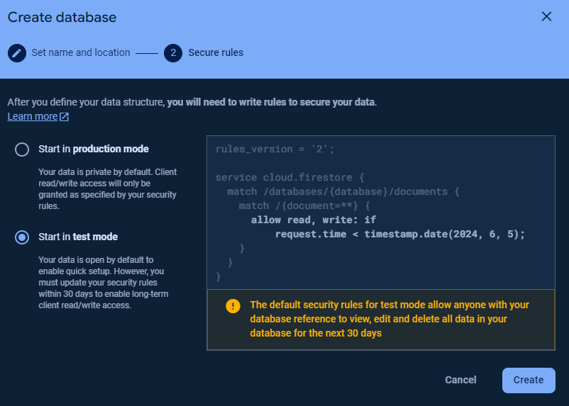
Step 3 - Set up database (part 2 of 2)
Start in production mode
Start in production 🎥
Start in test mode 🧪
In this walkthrough we will start in production mode (previously known as “lock mode” 🔒)
As of 2024/05/04

Slide 29
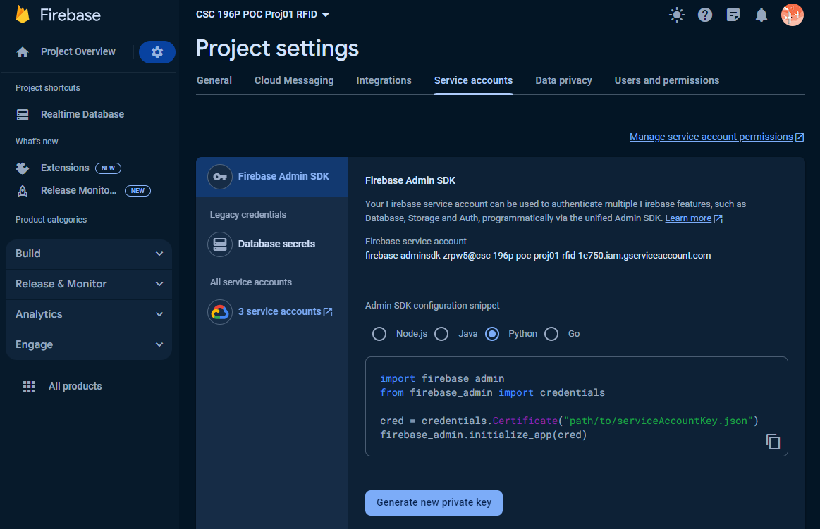
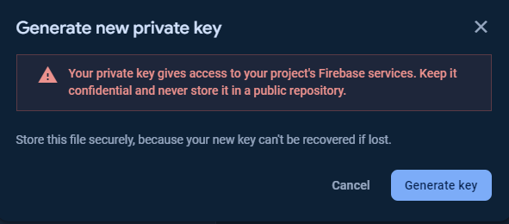
Step 4 Add Firebase to your web app (Part 1 of 2)
To obtain the serviceAccountKey.json file, you'll need to follow these steps:
Go to the Firebase Console: Visit the Firebase Console at https://console.firebase.google.com/
Select Your Project: If you already have a project, select it from the project list. If not, create a new project by clicking on the "Add project" button.
Navigate to Project Settings: Once you're in your project, click on settings (the gear icon) next to "Project Overview" in the left sidebar. Then select "Project settings".
Navigate to Service Accounts: In the project settings, select the "Service accounts" tab.
Generate New Private Key: Scroll down to the "Firebase Admin SDK" section. Under the "Firebase Admin SDK" tab, you'll see a section titled "Generate new private key". Click on the "Generate new private key" button to download the service account key file.
Save the File: Save the downloaded JSON file to a secure location on your computer. This file is your serviceAccountKey.json. If stored in your project folder add the file to .gitignore
Remember to keep the new private key secure and not share it publicly, as it contains sensitive information that grants access to your Firebase project. Once you have the serviceAccountKey.json file (AKA the firebase credentials), you can use it to initialize the Firebase Admin SDK in your Python script, as demonstrated in the examples.
As of 2024/05/04

Slide 30
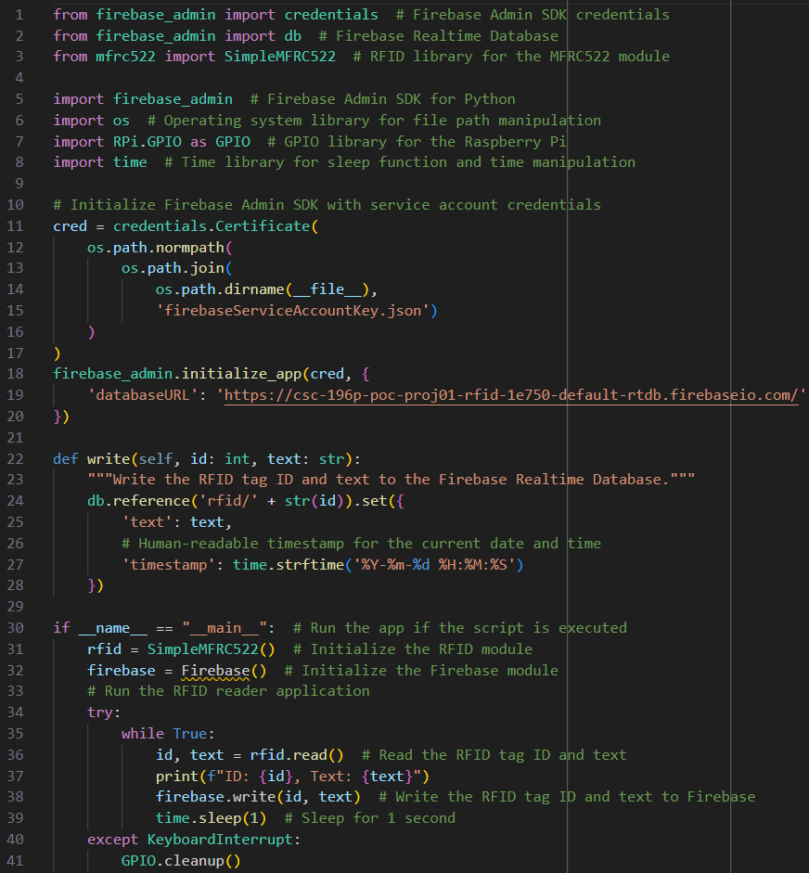
Step 4 Add Firebase to your web app (Part 2 of 2)
To obtain the serviceAccountKey.json file, you'll need to follow these steps:
Go to the Firebase Console: Visit the Firebase Console at https://console.firebase.google.com/
Select Your Project: If you already have a project, select it from the project list. If not, create a new project by clicking on the "Add project" button.
Navigate to Project Settings: Once you're in your project, click on settings (the gear icon) next to "Project Overview" in the left sidebar. Then select "Project settings".
Navigate to Service Accounts: In the project settings, select the "Service accounts" tab.
Generate New Private Key: Scroll down to the "Firebase Admin SDK" section. Under the "Firebase Admin SDK" tab, you'll see a section titled "Generate new private key". Click on the "Generate new private key" button to download the service account key file.
Save the File: Save the downloaded JSON file to a secure location on your computer. This file is your serviceAccountKey.json. If stored in your project folder add the file to .gitignore
Remember to keep the new private key secure and not share it publicly, as it contains sensitive information that grants access to your Firebase project. Once you have the serviceAccountKey.json file (AKA the firebase credentials), you can use it to initialize the Firebase Admin SDK in your Python script, as demonstrated in the examples.
As of 2024/05/04

Slide 31
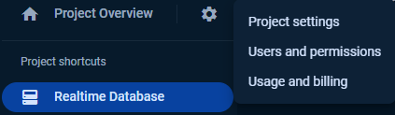
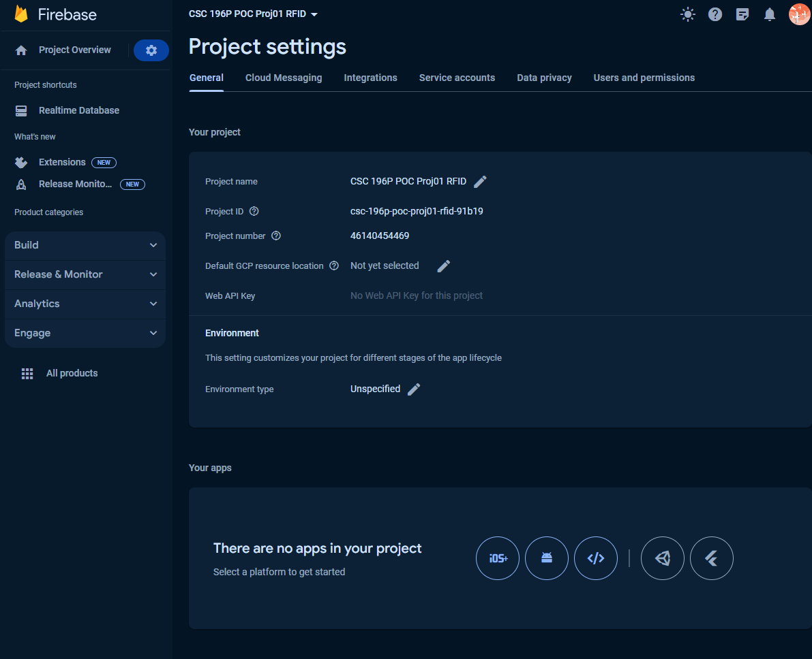
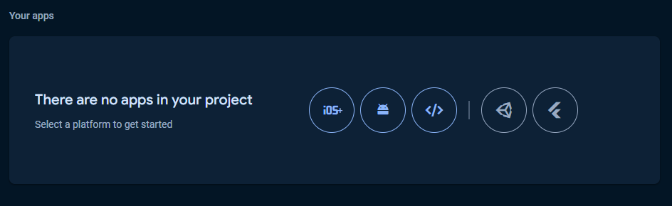
12) Project settings ➡️Add Firebase to App
Project Overview: Click the “gear” icon
Click “Project settings”
Scroll to the bottom of the “Project settings” page
Select the type of app you’d like to integrate with
Unity (game dev)
Android
Apple
iOS
Web
Flutter
(cross platform applications)
As of 2024/05/04

Slide 32

Enabling the Gmail API

Slide 33
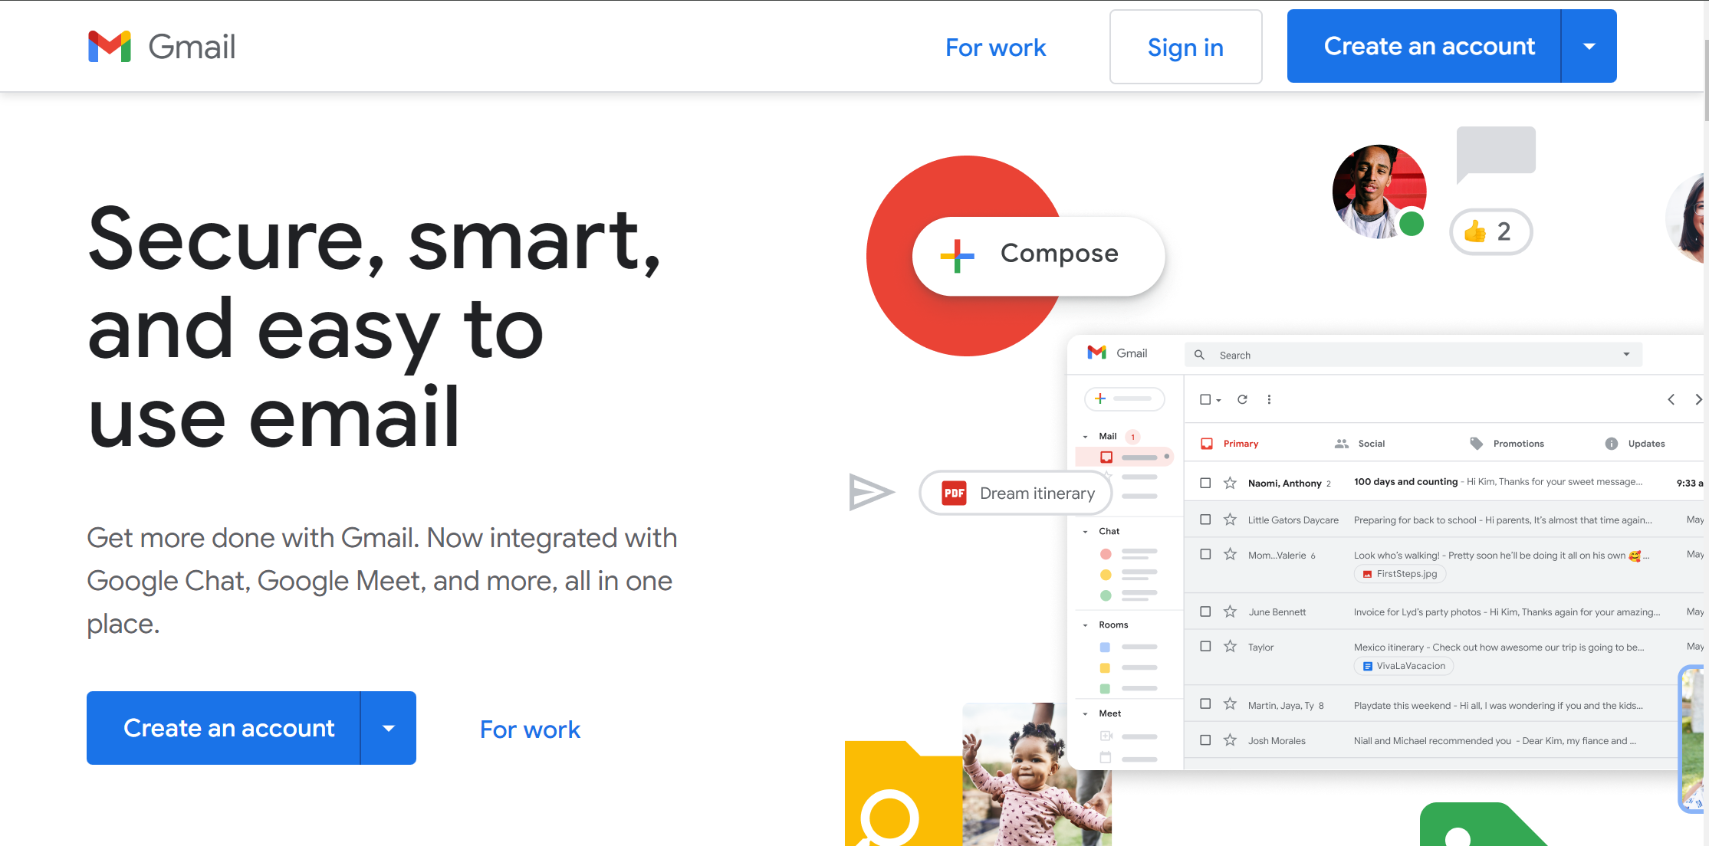
Step 1 – The basics
First sign up for a Gmail email account at https://gmail.com/ Skip if you already have an account – try to have a separate, development, account (i.e. different from your personal use account)

Slide 34
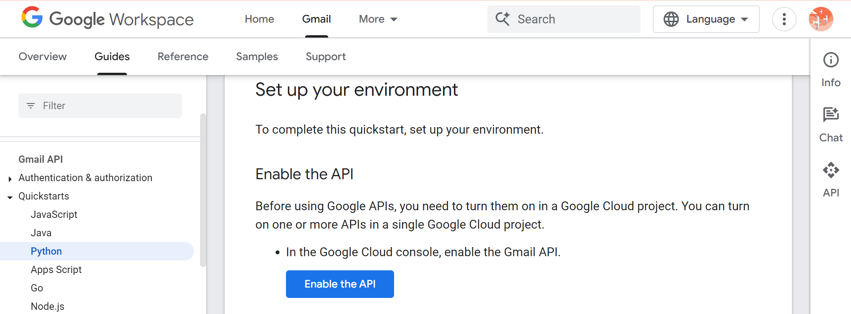
Step 2 – Enable the API
Then, go to https://developers.google.com/gmail/api/quickstart/python/, click the Enable the Gmail API button on that page, and fill out the form that appears.

Slide 35
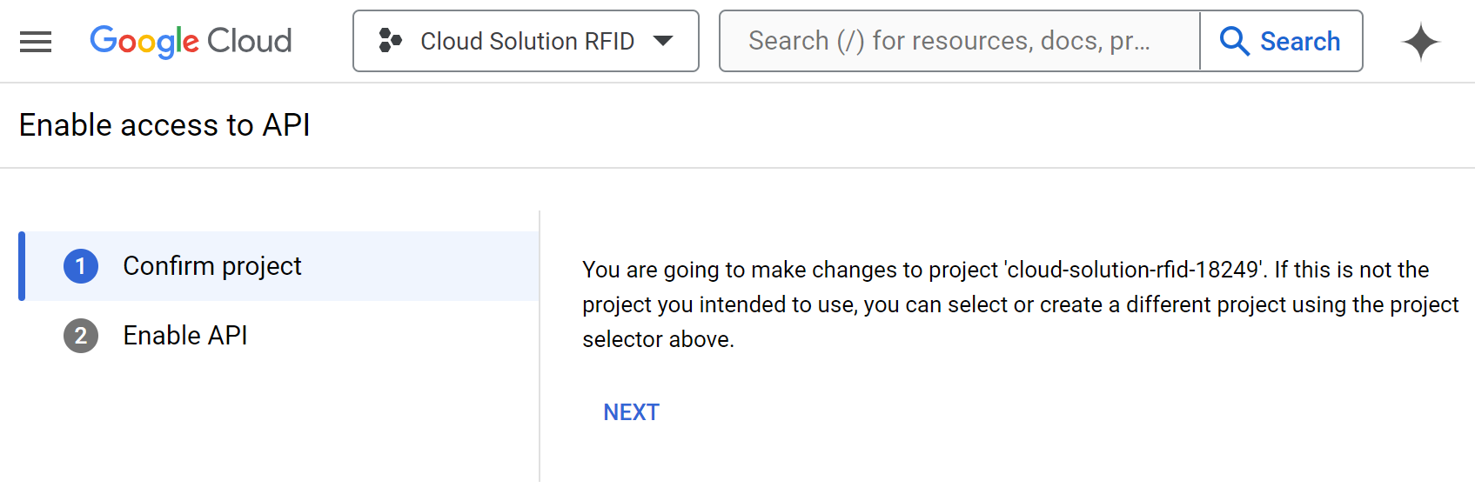
Step 3 – Enable access to API (part 1 of 2)
Make sure you have your project selected
Click “NEXT”

Slide 36
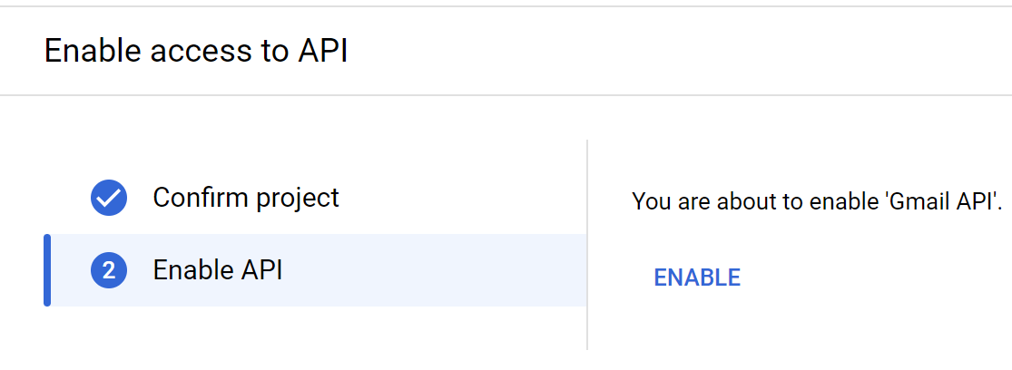
Step 3 – Enable access to API (part 2 of 2)
Click “ENABLE”

Slide 37

Demo time, lets do it live!

Slide 38


Setting the mood
Interactive Background Noise Generator

Slide 39
Questions?

Slide 40
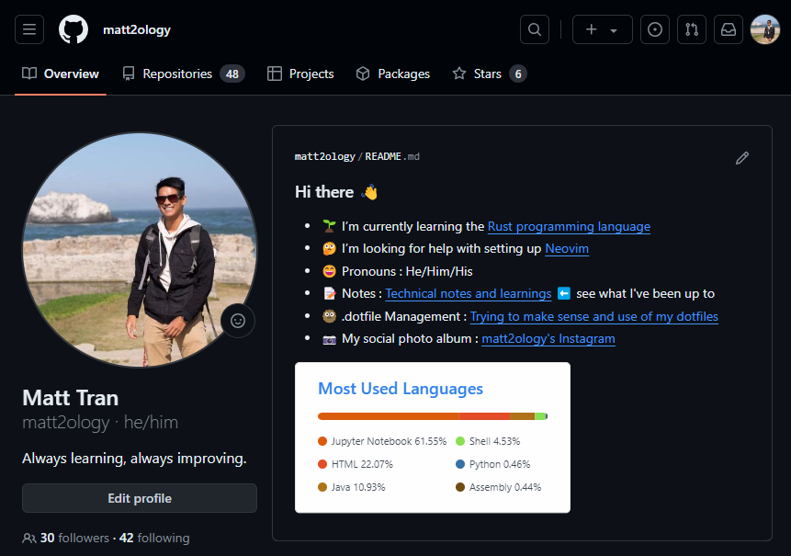
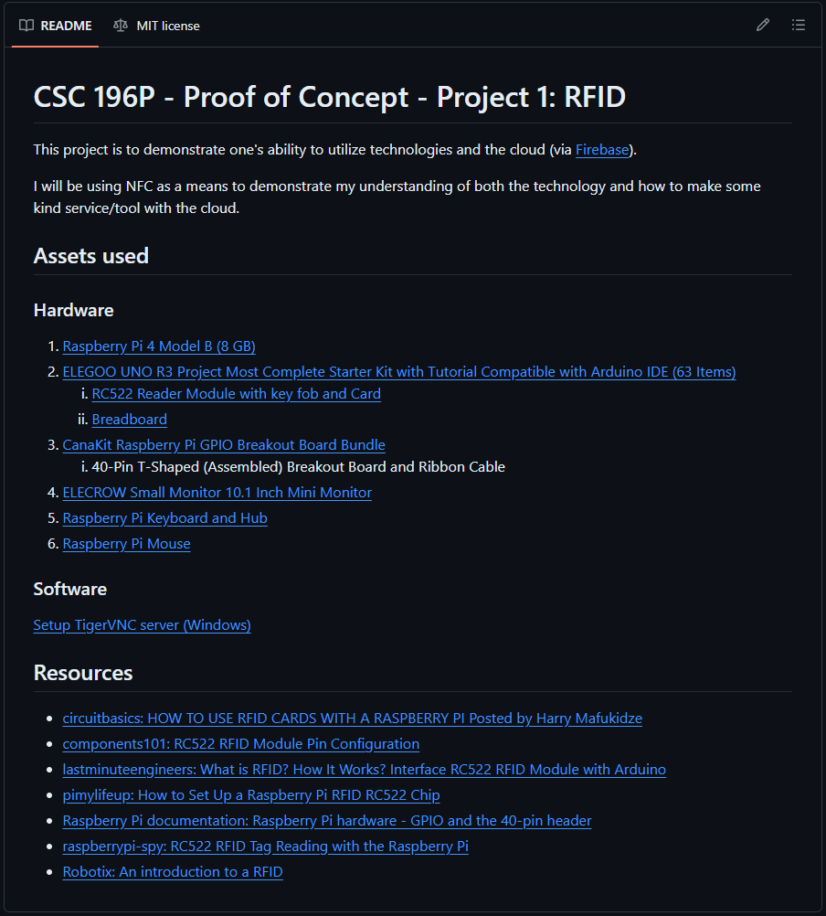
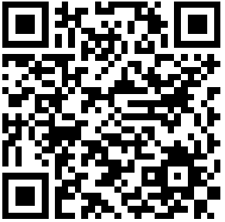

My GitHub - Matt2ology GitHub
OR CLICK TO REPO

Slide 41

Thank you

Slide 42
Resources
Learning & Tutorials
Hardware/Products Used
https://learn.sparkfun.com/tutorials/serial-communication/wiring-and-hardware
https://pinout.xyz/pinout/uart
https://pinout.xyz/pinout/spi
https://learn.adafruit.com/mini-thermal-receipt-printer/overview
https://learn.adafruit.com/networked-thermal-printer-using-cups-and-raspberry-pi/overview
https://circuitdigest.com/microcontroller-projects/thermal-printer-interfacing-with-raspberry-pi-zero-to-print-text-images-and-bar-codes
Firebase Database Rules Tutorial
Micro Thermal Printer 5~9V Embedded Thermal Receipt Printer Serial Port Microcontroller Secondary Development MCU Printing Module TTL/RS232
57x30mm Thermal Paper White 10 Rolls
JST-PH 2-pin Jumper Cable - 100mm long
Duttek USB to PH2.0 Cable, PH2.0 Female to USB 2.0 Male to 4 pin Data Cable
STEMMA Cable - 4 Pin JST-PH 2mm Cable–Female/Female
SunFounder Reader Module Kit Mifare RC522 Reader Module
For fun/recommended: SunFounder Starter Kit for Raspberry Pi 5

Slide 43
Wiring for Thermal Printer VIA TTL/RS262
Thermal Printer 🖨️ |  | Raspberry Pi
TTL/RS232 - Ground (GND) | Black | Board PIN 6: Ground (GND)
TTL/RS232 - Transmit (TX) | Yellow | Board PIN 8: GPIO 14 (UART Transmit)
TTL/RS232 - Receive (RX) | Green | Board PIN 10: GPIO 15 (UART Receive)
Power Port - Voltage Common Collector (VCC) |  | Board PIN 2/4: 5v Power
Power Port - Ground (GND) |  | Board PIN 9/14: Ground (GND)
Source: Connect and Configure Printer

Slide 44
Wiring for Thermal Printer VIA USB
Thermal Printer 🖨️ | Raspberry Pi
Power Port - Voltage Common Collector (VCC) | Board PIN [2,4]: 5v Power
Power Port - Ground (GND) | Board PIN [6,9,14,20,25, 34, 39]: Ground (GND)

Slide 45

Create a Realtime database
From “Project categories”, under “BUILD” dropdown menu, select “Realtime Database”, Click “Create Database”
As of 2024/05/04

Slide 46

10) Set up database (part 1 of 2)
Select the region that best suits your location
Click “Next”
As of 2024/05/04

Slide 47


10) Set up database (part 2 of 2)
Start in locked mode 🔒
Start in test mode 🧪
In this walkthrough we will start in “lock mode” 🔒
As of 2024/05/04

Slide 48


11) Edit Rules (If started in locked mode 🔒)
Go to the “Rules” tab
Change read and write values to “true”
and then click “Publish”
⚠️ You will get a prompt: “security rules are defined as public,
so anyone can steal, modify, or delete data in your database”.
Because this is just a proof of concept this can be ignored.
As of 2024/05/04

Slide 49
12) Project settings ➡️Add Firebase to App
Project Overview: Click the “gear” icon
Click “Project settings”
Scroll to the bottom of the “Project settings” page
Select the type of app you’d like to integrate with
Unity (game dev)
Android
Apple
iOS
Web
Flutter
(cross platform applications)
As of 2024/05/04

Slide 50
Add Firebase to your web app
To obtain the firebase_credentials.json file, you'll need to follow these steps:
Go to the Firebase Console: Visit the Firebase Console at https://console.firebase.google.com/
Select Your Project: If you already have a project, select it from the project list. If not, create a new project by clicking on the "Add project" button.
Navigate to Project Settings: Once you're in your project, click on the gear icon (settings) next to "Project Overview" in the left sidebar. Then select "Project settings".
Navigate to Service Accounts: In the project settings, select the "Service accounts" tab.
Generate New Private Key: Scroll down to the "Firebase Admin SDK" section. Under the "Firebase Admin SDK" tab, you'll see a section titled "Generate new private key". Click on the "Generate new private key" button to download the service account key file.
Save the File: Save the downloaded JSON file to a secure location on your computer. This file is your firebase_credentials.json.
Remember to keep this file secure and not share it publicly, as it contains sensitive information that grants access to your Firebase project. Once you have the firebase_credentials.json file, you can use it to initialize the Firebase Admin SDK in your Python script, as demonstrated in the previous examples.
As of 2024/05/04

Slide 51

Django
Python web framework
https://www.djangoproject.com/

Slide 52
Step 1
Create your virtual environment
python -m venv .venv
Activate your virtual environment
.venv/Scripts/activate
Prerequisite for Application
Update PIP
python.exe -m pip install --upgrade pip
Install Django
pip install django

Slide 53

Step 2
Create the project
django-admin startproject <projectName>
Django Project
_init_.py: tells Python
to treat the directory as a package
asgi.py & wsgi.py: are special config files that allows Django to communicate with the web server
settings.py: contains a bunch of settings to install applications, install plug-ins, middleware, and modify database engines
Create application
I’ll be naming my project name: “rfidDemo”
urls.py: allow us to configure different URL routes to different Django applications
manage.py: a special file that acts as a command line tool to made database migrations, run Python server, and etc.

Slide 54
Step 3
Install the Firebase Admin SDK for Python.
You can do this via pip:
pip install firebase-admin
Install Firebase Admin SDK
Use Firebase as your database backend instead of SQLite in a Django project

Slide 55
Step 4
Set up Firebase Project: Create a Firebase project in the Firebase console if you haven't already done so.
SEE TO: RECAP Setting up the cloud via Firebase
Once you have a project, you'll need to generate a private key file. Go to Project Settings > Service accounts and generate a new private key. This file will be used to authenticate your Django app with Firebase

Slide 56



Step 5
Configure Django Settings
Replace "path/to/firebase/serviceAccountKey.json" with the path to the private key file you downloaded from the Firebase console. Also, replace 'your-firebase-database-url' with the URL of your Firebase Realtime Database or Firestore.

Slide 57

Django - Single Sign-on (SSO) Via Auth0
add authentication and authorization to your applications
https://auth0.com/

Slide 58

Step 1: Sign up
Click inside the green box
As of 2024/05/04

Slide 59


Step 2: Choose A Sign-up Option
I will continue with Google
As of 2024/05/04

Slide 60


Step 3: Select Applications
1
From the dashboard’s side panel click “Applications”
Select “Applications” from the drop-down list
2
As of 2024/05/04

Slide 61


Step 4: Create Application
1
Click the “Create Application” button
Give your app a name
Choose an application type
For this project I’ll be using “Regular Web Applications”
2
3
As of 2024/05/04

Slide 62

Step 5: Select the technology for project
For this project I’ll be using Django
Selecting the technology will then present a tutorial that demonstrates how to add user login to a Django application using Auth0
Source: Auth0 Python Web App Sample, Django Quickstart
As of 2024/05/04

Slide 64

Implementation Web Platform via Python

Slide 65
Add Firebase to your web app
To obtain the firebase_credentials.json file, you'll need to follow these steps:
Go to the Firebase Console: Visit the Firebase Console at https://console.firebase.google.com/
Select Your Project: If you already have a project, select it from the project list. If not, create a new project by clicking on the "Add project" button.
Navigate to Project Settings: Once you're in your project, click on the gear icon (settings) next to "Project Overview" in the left sidebar. Then select "Project settings".
Navigate to Service Accounts: In the project settings, select the "Service accounts" tab.
Generate New Private Key: Scroll down to the "Firebase Admin SDK" section. Under the "Firebase Admin SDK" tab, you'll see a section titled "Generate new private key". Click on the "Generate new private key" button to download the service account key file.
Save the File: Save the downloaded JSON file to a secure location on your computer. This file is your firebase_credentials.json.
Remember to keep this file secure and not share it publicly, as it contains sensitive information that grants access to your Firebase project. Once you have the firebase_credentials.json file, you can use it to initialize the Firebase Admin SDK in your Python script, as demonstrated in the previous examples.
As of 2024/05/04

Slide 66



Scan for RFID Tag

Slide 67


Write to Firebase Realtime Database

Slide 68

Register app

Slide 69


Add Firebase SDK
Use npm
Use a <script> tag

